Slide 1

European Project Center,
Dr.Laima Gerlitz & Elizaveta Diatlova

Slide 2
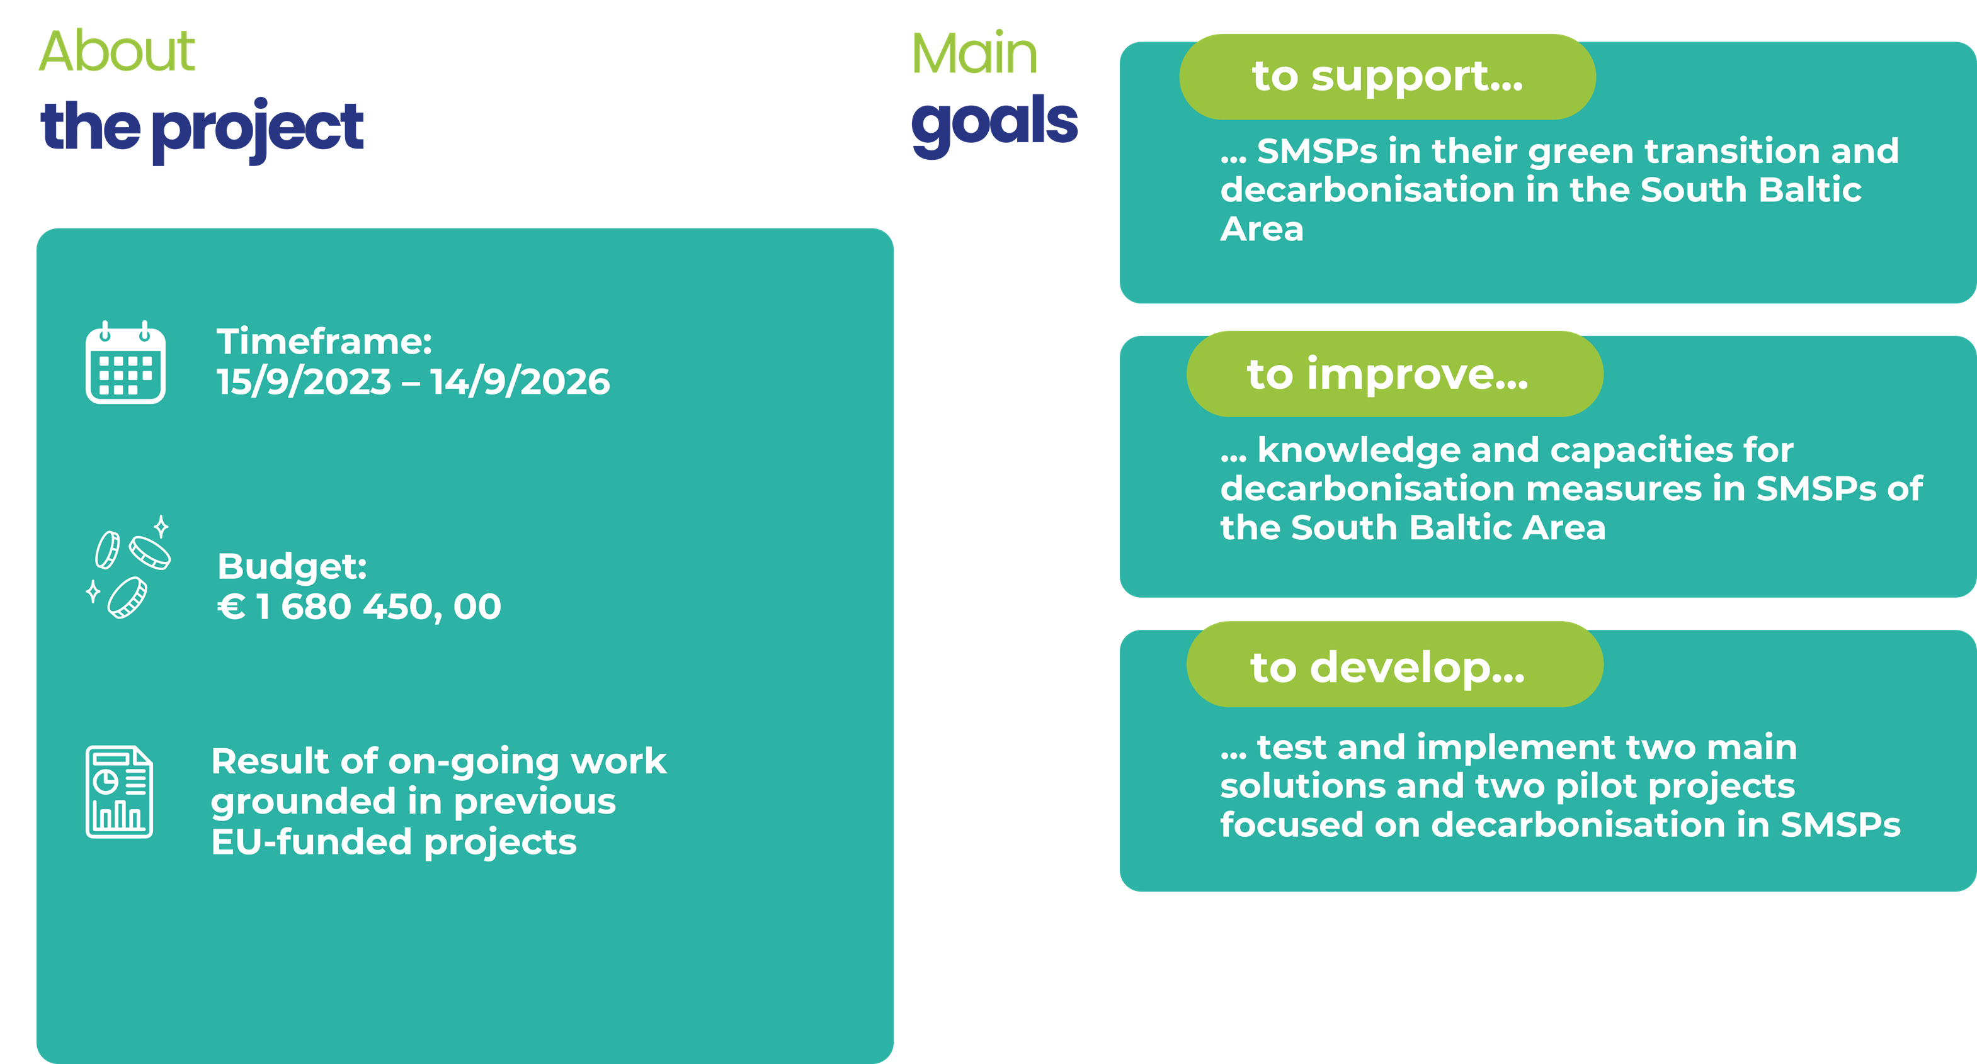
European Project Center,
Dr.Laima Gerlitz & Elizaveta Diatlova

Slide 3

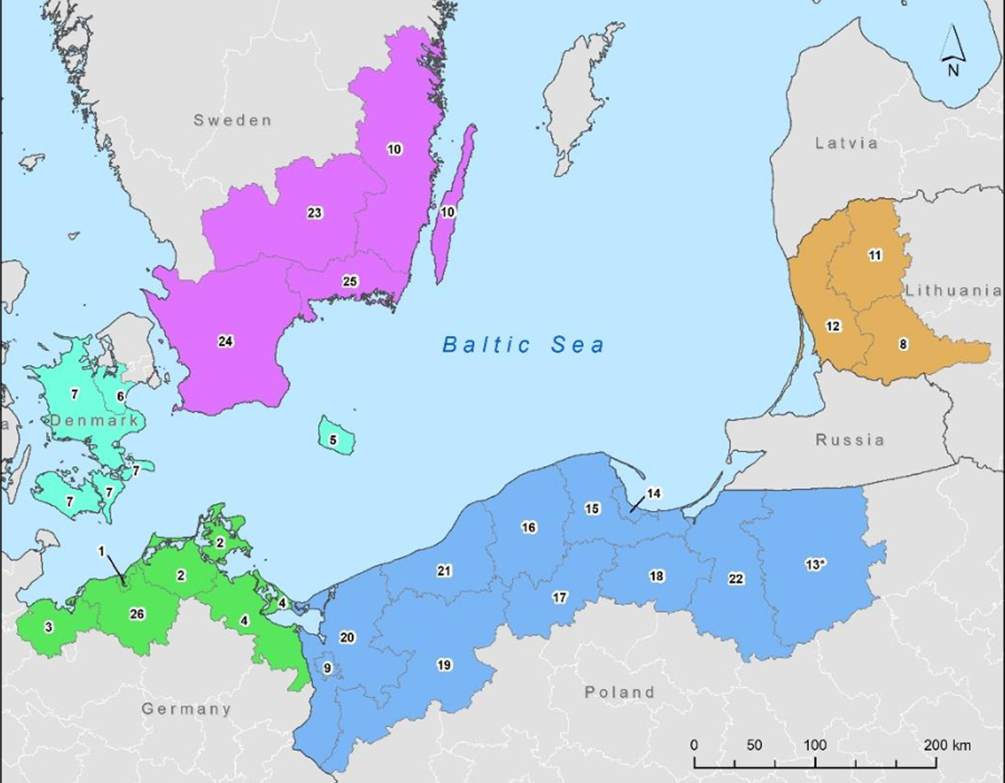
The Interreg South Baltic Programme 2021 -2027 in question is being developed by five countries of the South Baltic area: Denmark, Germany Lithuania, Sweden and Poland, the latter coordinating and managing the ongoing work.
The Programme currently covers 25 coastal areas of the region with an area of approx. 118,000 km2, inhabited by approx. 8.9 mln people.
The vision outlined in the Programme, reads: “United by the Sea into action for a blue and green future. Innov ative, Sustainable, Attractive and Active South Baltic.”
The Programme provides support for international projects within its defined area.
It does not therefore define specific investment projects that may have a direct impact on the environment, but it does set out a framework of possible support for such projects.
European Project Center,
Dr.Laima Gerlitz & Elizaveta Diatlova

Slide 4

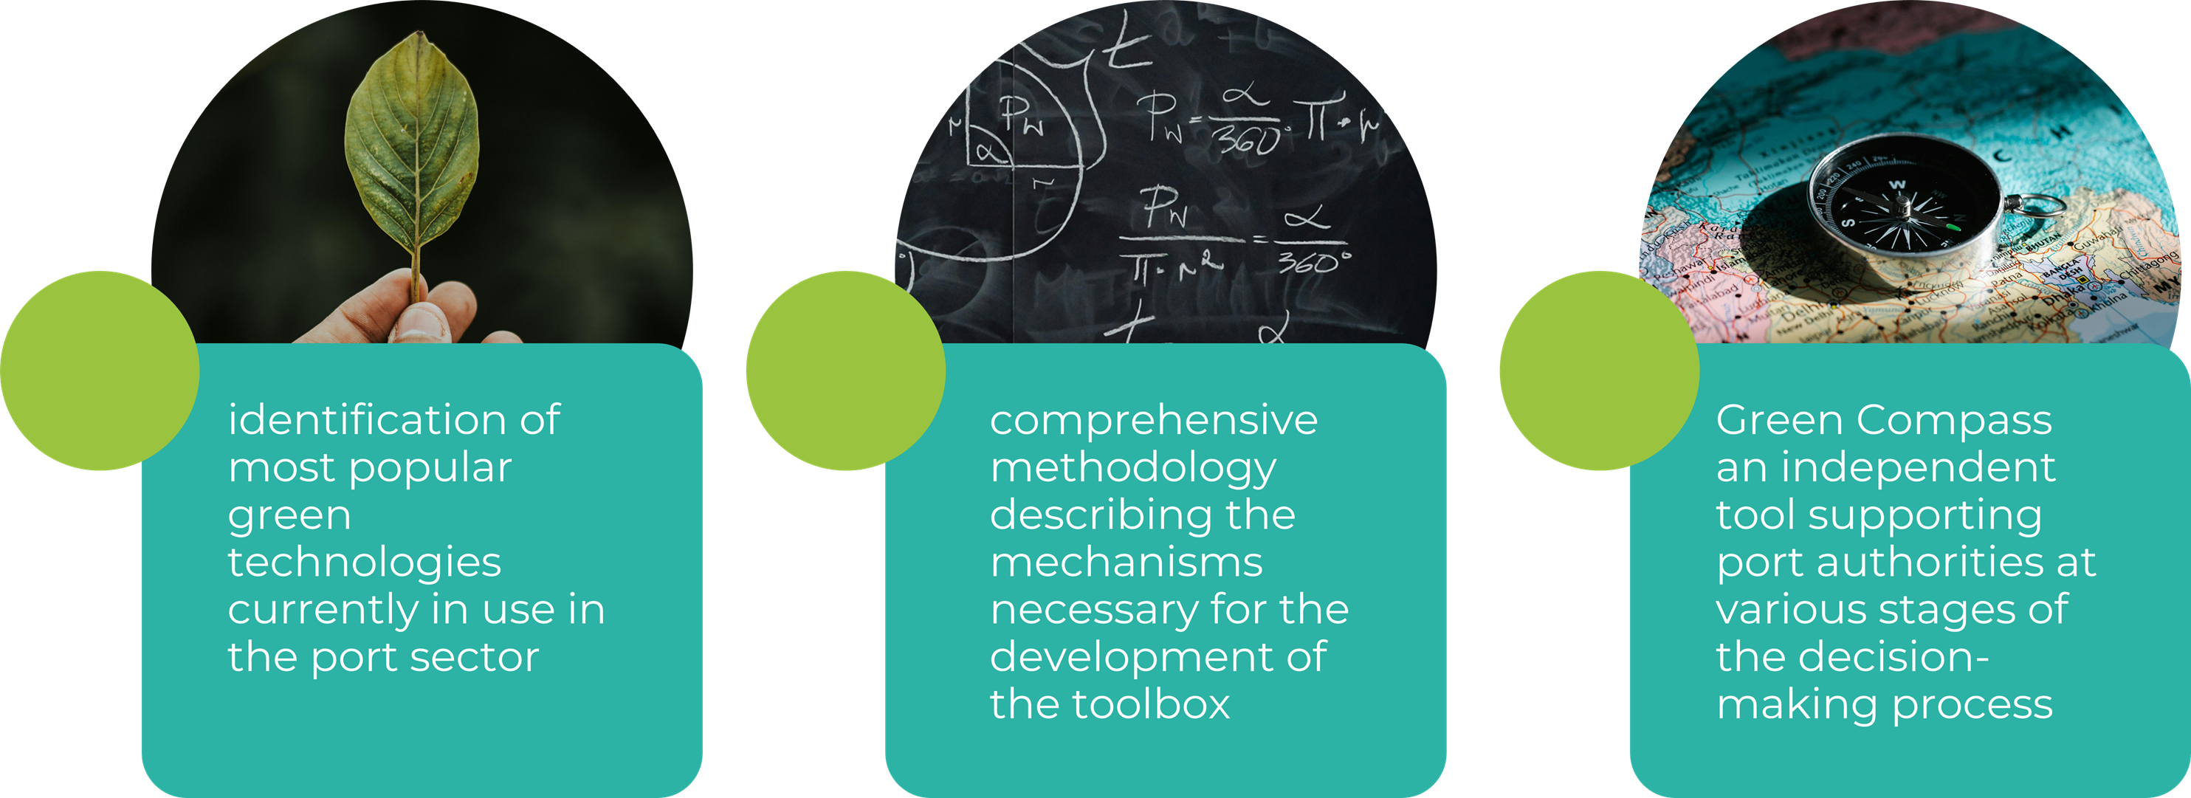
European Project Center,
Dr.Laima Gerlitz & Elizaveta Diatlova

Slide 5

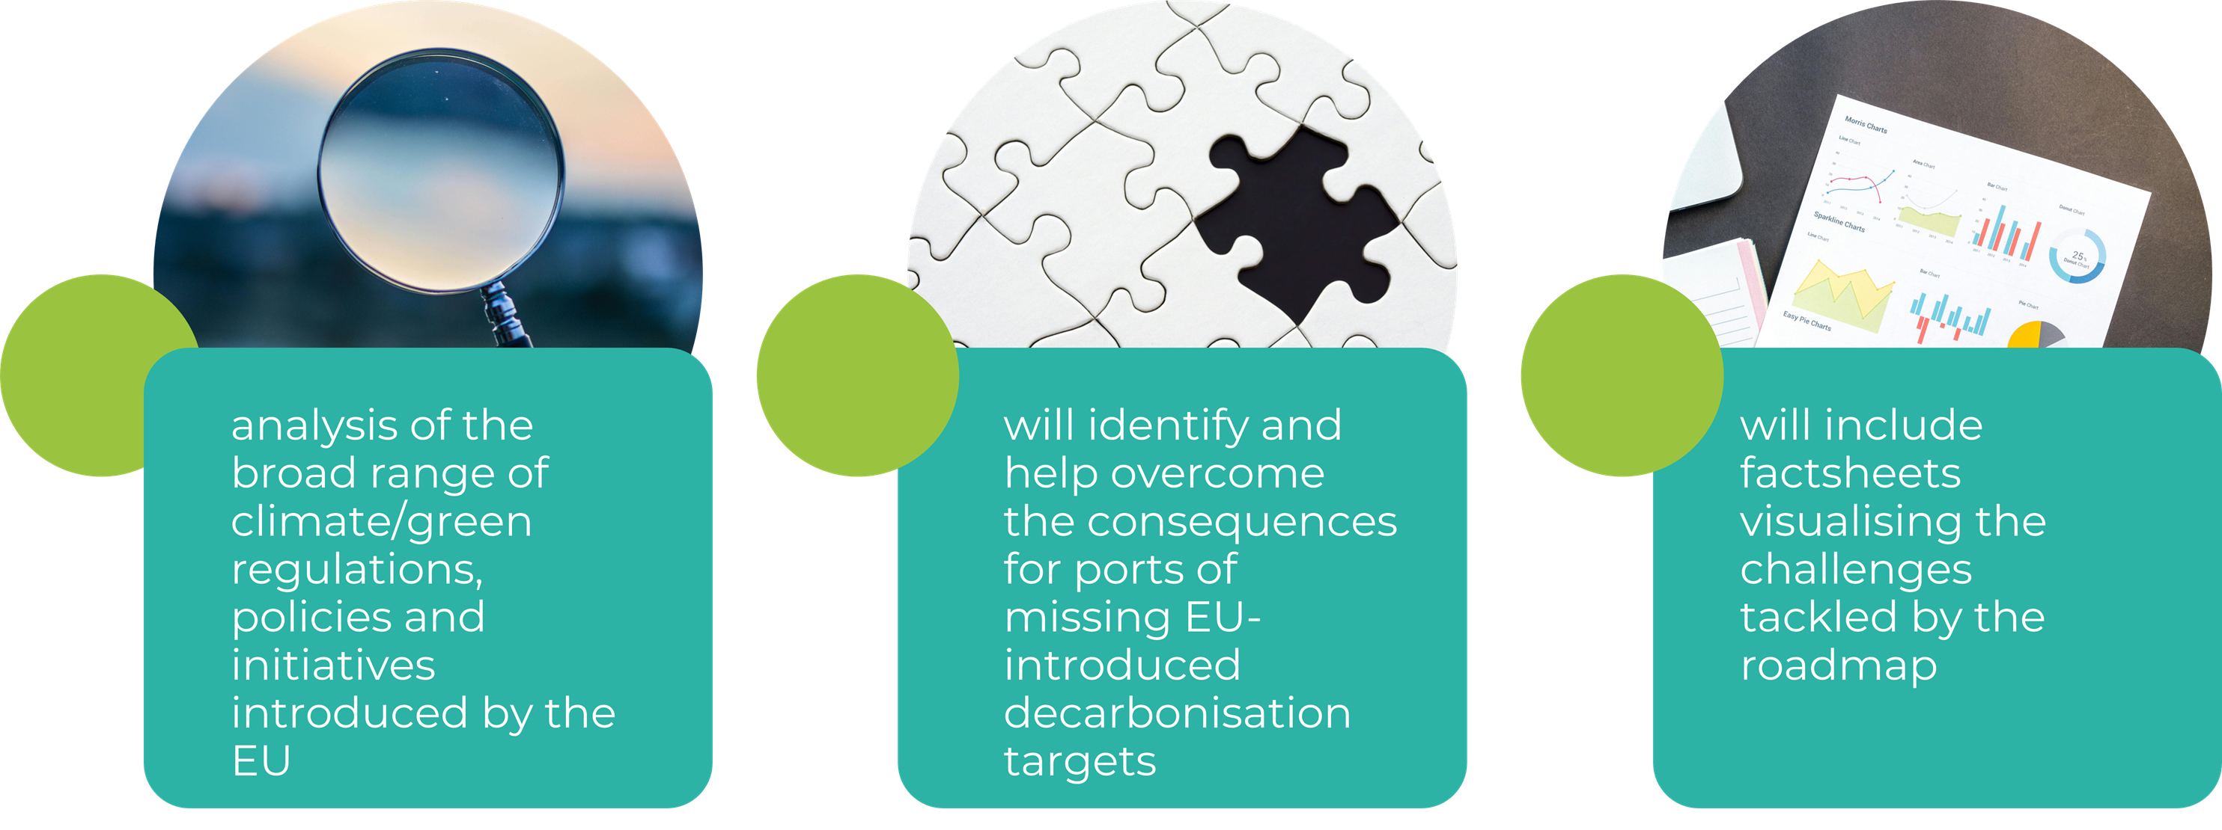
European Project Center,
Dr.Laima Gerlitz & Elizaveta Diatlova

Slide 6
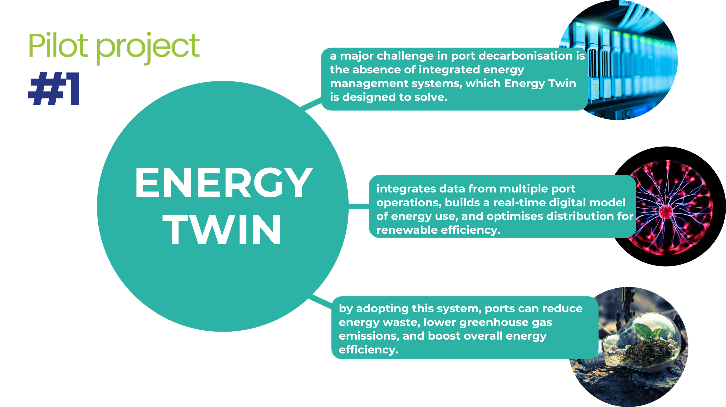
European Project Center,
Dr.Laima Gerlitz & Elizaveta Diatlova

Slide 7
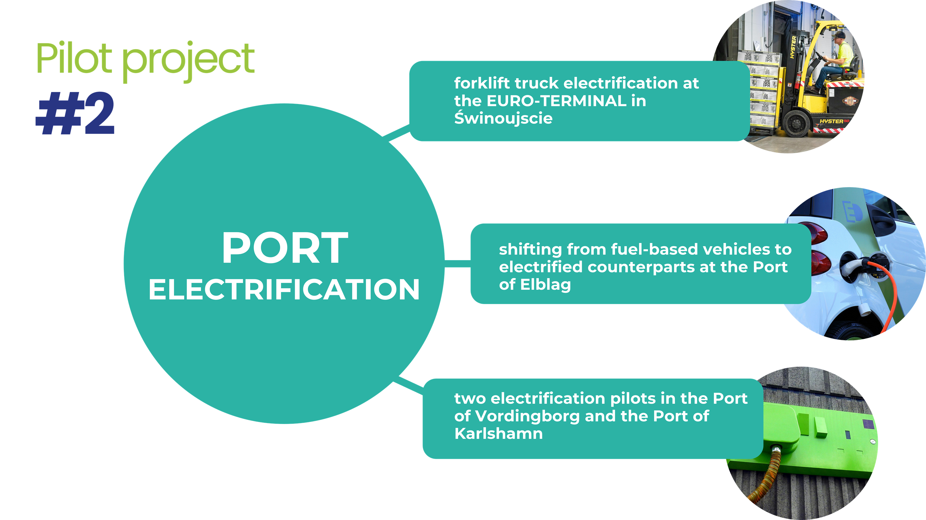
European Project Center,
Dr.Laima Gerlitz & Elizaveta Diatlova

Slide 8

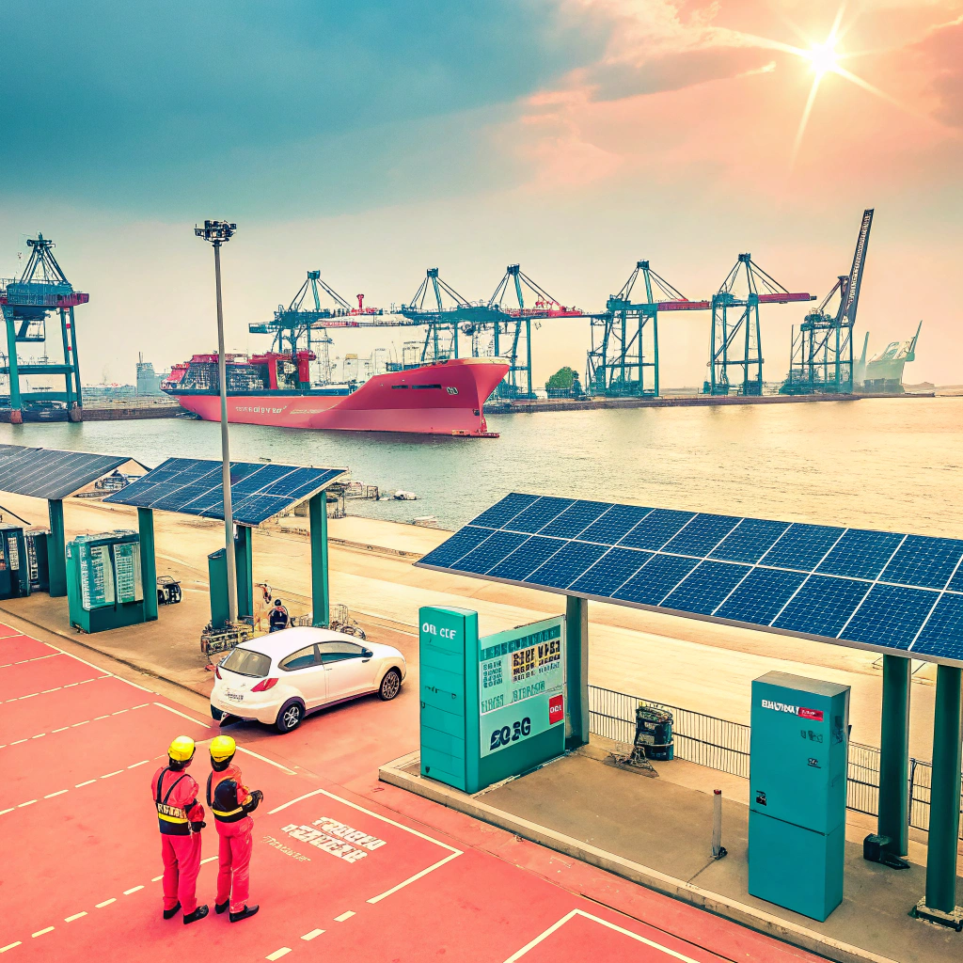
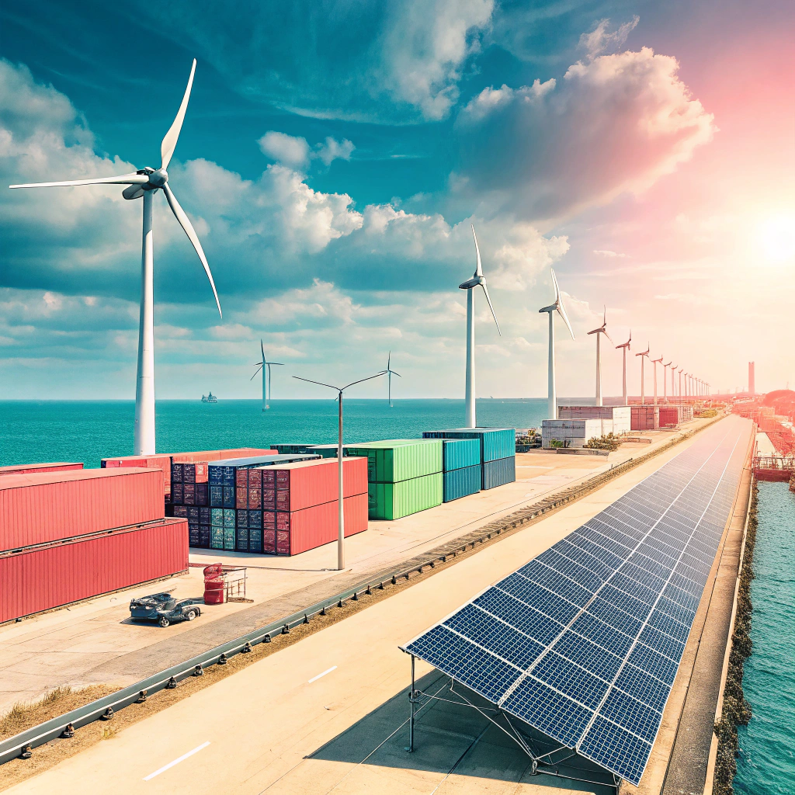
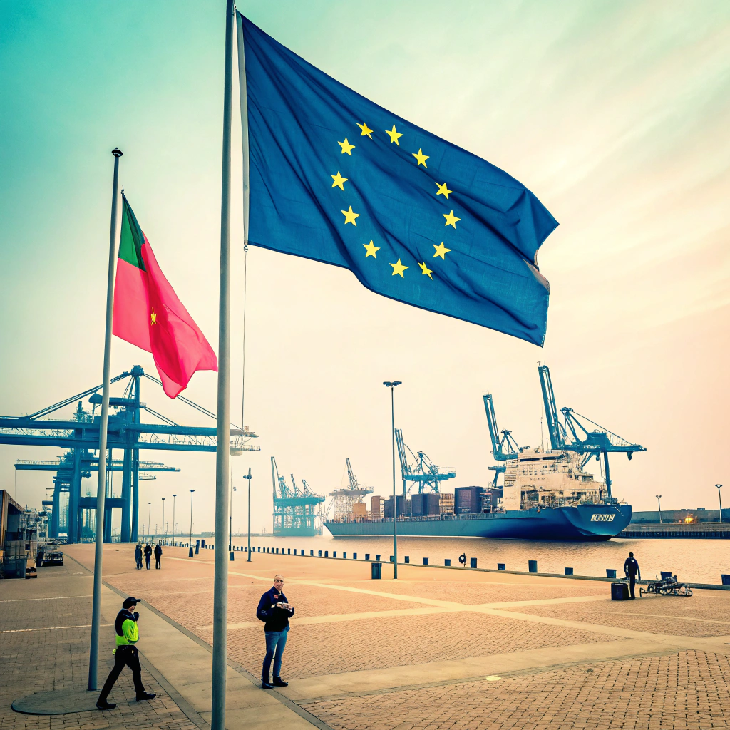
Harmonisation Toolbox
Decision Tool: Digital template for investment planning.
Compliance Checklist: Ensures EU green policy adherence.
Value Calculator: Boosts business value via green standards.
Adoption: 6+ pilot ports.
2. Decarbonisation Pilots
Energy Twin: Enhances efficiency, simulates renewables (Klaipeda, Ystad, Rostock).
Port Electrification: Shifts to green energy operations (Świnoujście, Stralsund, Elblag).
Benefit: Diverse, adaptable solutions.
3. Green Policy Roadmap
Competence: Skills needed post-2030.
Technology: Infrastructure requirements.
Socio-Environmental: Benefits for community and environment.
Format: Interactive strategic report.
European Project Center,
Dr.Laima Gerlitz & Elizaveta Diatlova

Slide 9
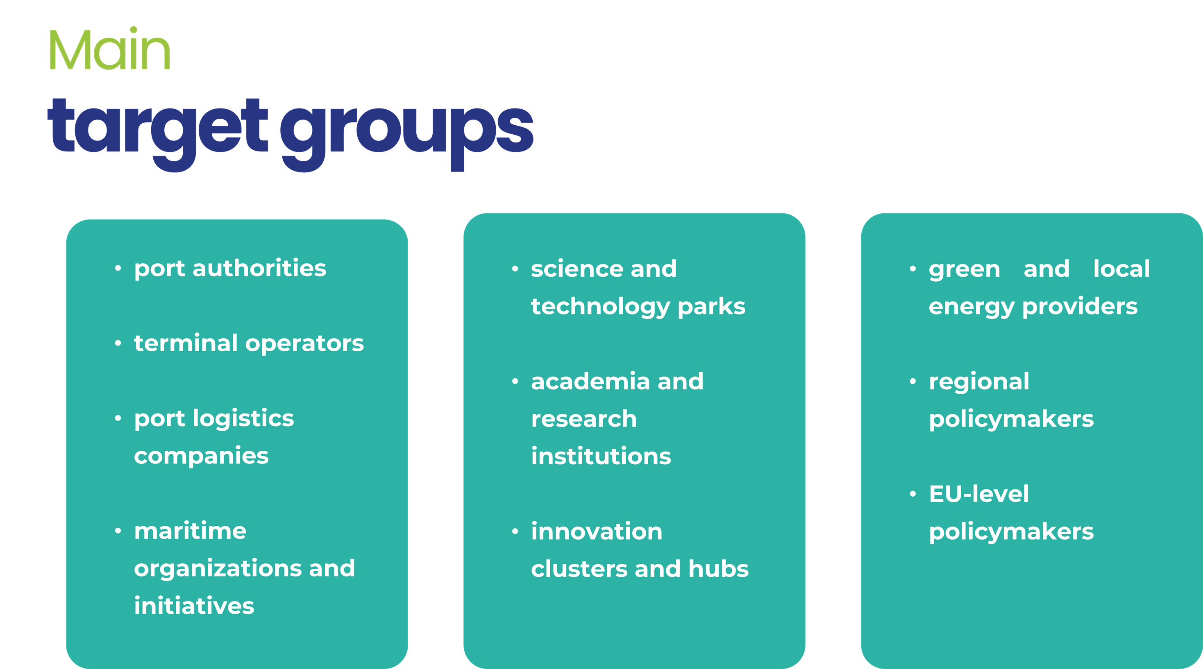
European Project Center,
Dr.Laima Gerlitz & Elizaveta Diatlova

Slide 10

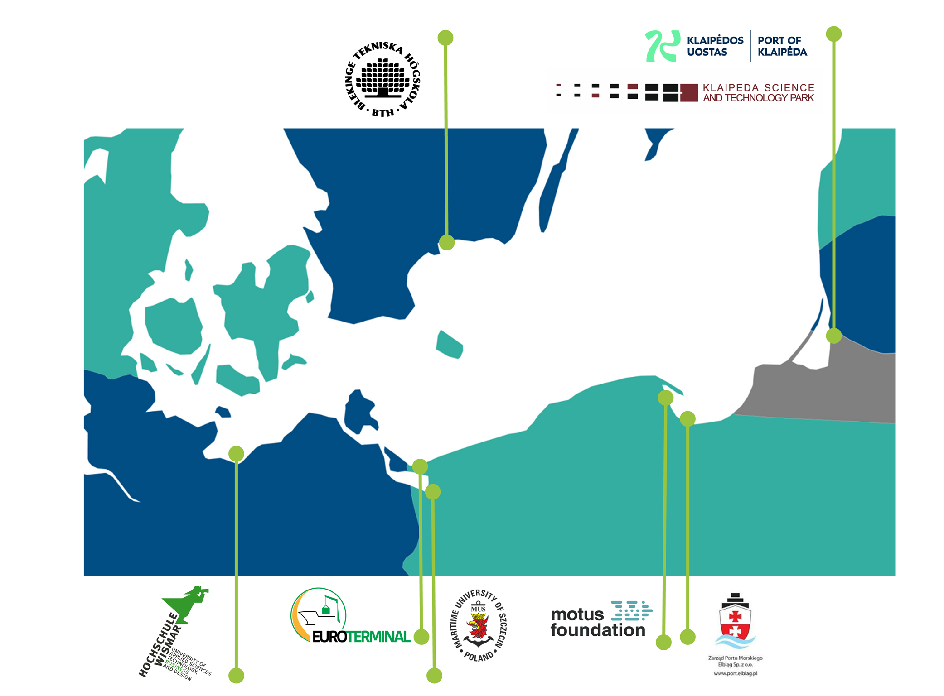
Hochschule Wismar, University of Applied Sciences (DE)
Klaipeda Science and Technology Park (LT)
Motus Foundation (PL)
Blekinge Institute of Technology (SE)
Maritime University of Szczecin (PL)
Elblag Sea Port Authority Ltd. (PL)
Klaipeda State Seaport Authority (LT)
Euro-Terminal Sp. Z o.o. (PL)
European Project Center,
Dr.Laima Gerlitz & Elizaveta Diatlova

Slide 11

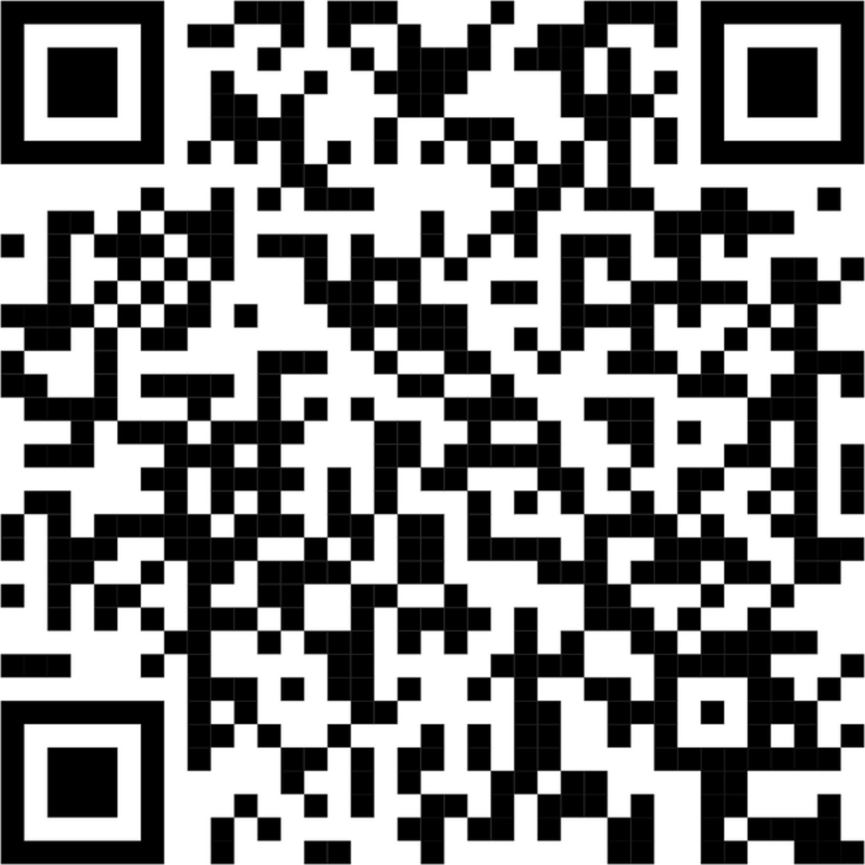
European Project Center,
Dr.Laima Gerlitz & Elizaveta Diatlova

Slide 12


European Project Center,
Dr.Laima Gerlitz & Elizaveta Diatlova

